Slide 1

DEPARTMENT OF COMPUTER SCIENCE AND ENGINEERING
Professional Training - 1
TRANSPORTATION AND LOGISTICS PERFORMANCE DASHBOARD
PROJECT STUDENT GUIDE
ADHAVA G L, Dr.A.C.SANTHA SHEELA, M.E., Ph.D.,
42110025 Associate Professor, CSE

Slide 2
AGENDA
Certificate
Introduction
Abstract
Objective
System Architecture / Ideation Map
Module Implementation
Results and Discussions
Conclusion
References

Slide 3

COURSE CERTIFICATE
29 October 2024

Slide 4
INTRODUCTION
Importance of Transportation & Logistics: Efficient logistics management is crucial for optimizing supply chains, reducing costs, and ensuring customer satisfaction in today’s fast-paced global economy.
Challenges Faced: Rising consumer expectations demand faster, more efficient deliveries. Poor logistics can lead to higher costs, delayed shipments, and unsatisfied customers.
Role of Technology: Leveraging advanced data-driven tools helps organizations stay competitive by offering insights to optimize operations and streamline processes.
Project Overview:
This project aims to develop a Transportation and Logistics Performance Dashboard using Power BI to provide real-time insights into key logistics metrics such as delivery times, shipment tracking, vehicle utilization, and route efficiency.

Slide 5
ABSTRACT
This project focuses on developing a Transportation and Logistics Performance Dashboard to optimize logistics operations. It integrates data from multiple sources to track key metrics like delivery times, fleet utilization, and fuel efficiency. With real-time insights, predictive analytics, and interactive visualizations, the dashboard helps identify issues, enhance decision-making, and improve overall efficiency in logistics management.

Slide 6
OBJECTIVE
To develop a Transportation and Logistics Performance Dashboard using Power BI that provides real-time insights into key logistics metrics such as delivery times, fleet utilization, route efficiency, and supply chain bottlenecks. The goal is to enhance decision-making, improve operational efficiency, reduce costs, and ensure seamless logistics management through interactive visualizations and data-driven analytics.

Slide 7
LITERATURE SURVEY
Performance Measurement:
Logistics dashboards track key metrics like delivery times, fleet utilization, and costs to enhance operational transparency and efficiency​AIS eLibrary
Technology Integration:
Tools like Power BI enable real-time data integration and visualization, improving decision-making and optimizing logistics operations​AIS eLibrary
Balanced Frameworks:
Adopting frameworks such as the Balanced Scorecard helps align logistics processes with business goals, balancing cost and service quality​Munich Personal RePEc Archive
Predictive Analytics:
Dashboards with predictive capabilities anticipate potential challenges, driving continuous improvements through KPI monitoring​Munich Personal RePEc Archive

Slide 8
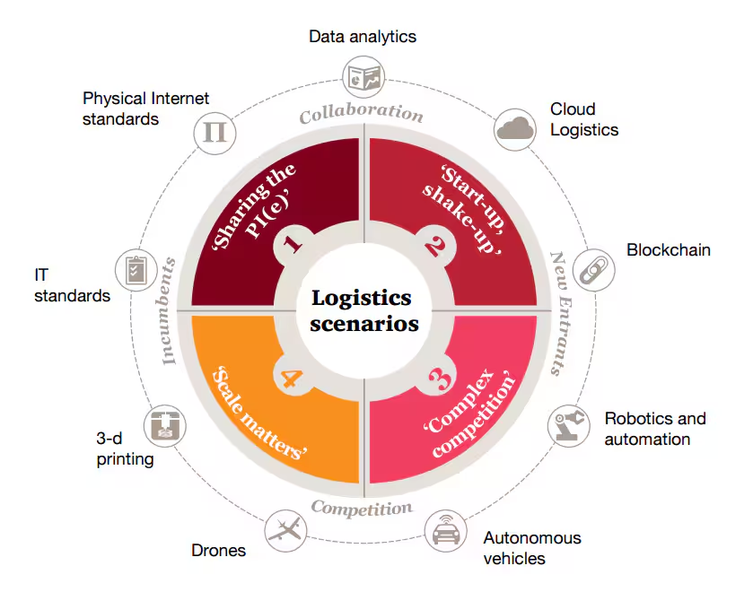
SYSTEM ARCHITECTURE / IDEATION MAP

Slide 9
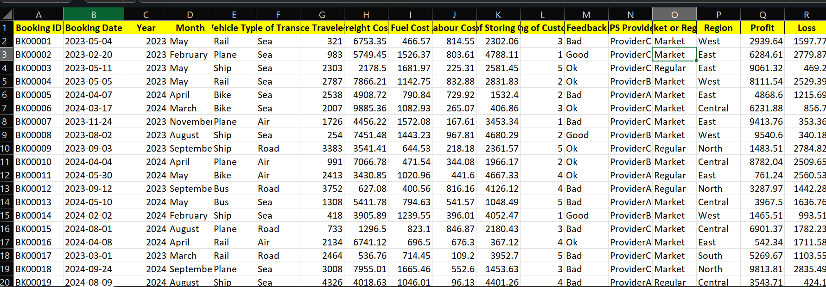
MODULE IMPLEMENTATION
Methodology Overview
Phases: Data Collection → Preparation → Design → Implementation → Maintenance
Tool: Power BI (Real-time updates, intuitive interface, predictive analytics potential)
Data Collection
Internal: Shipment tracking, delivery schedules, vehicle stats, route performance
External: APIs (traffic/weather), historical Excel data

Slide 10
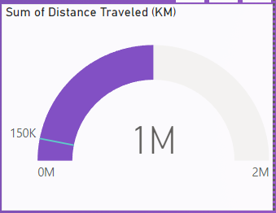
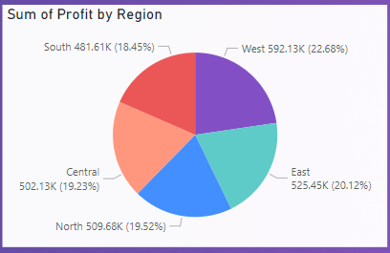
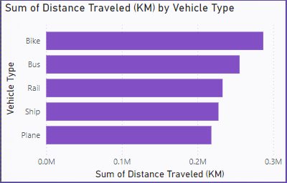
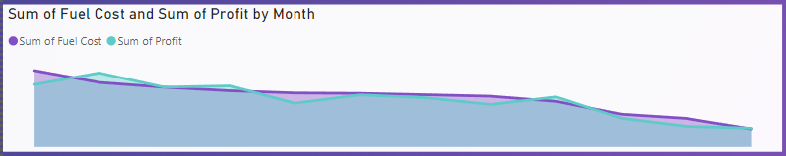
MODULE IMPLEMENTATION
3.Dashboard Design
Visuals: Bar charts, heatmaps, pie charts, line graphs
Features: Filters, drill-downs for detailed insights

Slide 11
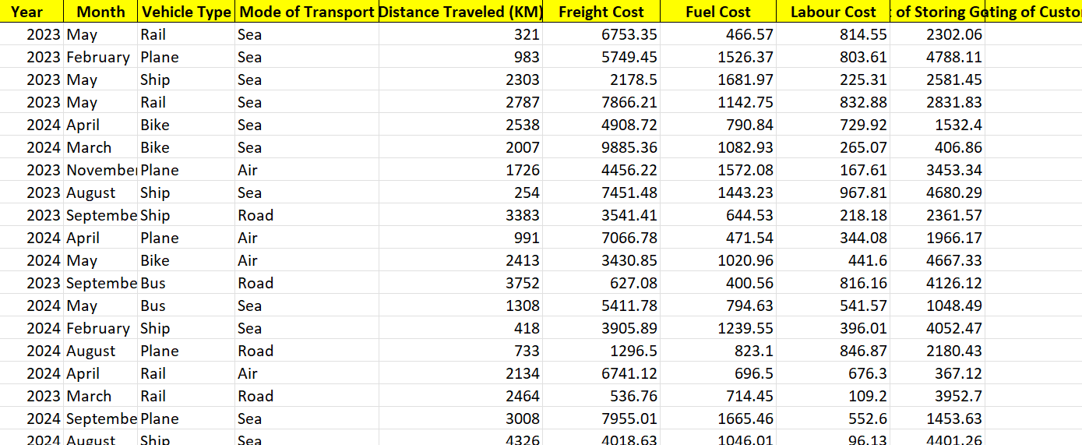
MODULE IMPLEMENTATION
4.Data Preparation
Cleaning: Remove duplicates, handle missing data, correct errors
Structuring: Standardize formats, establish relationships, compute KPIs (e.g., on-time delivery)

Slide 12
MODULE IMPLEMENTATION
Implementation
Data Sources: Excel, APIs (for real-time insights)
Interactive Visuals with live updates for decision-making
Maintenance
Regular updates, performance monitoring, user feedback integration
Future plans: Predictive analytics, mobile compatibility
This structured approach ensures real-time, actionable insights for effective logistics management

Slide 13
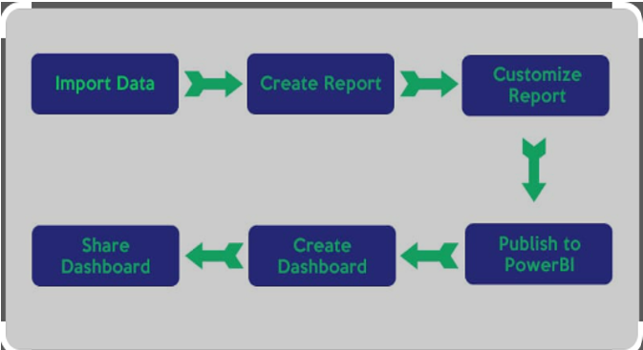
MODULE IMPLEMENTATION

Slide 14
RESULTS AND DISCUSSIONS
In our product return rate analysis project, we successfully created dashboards using Tableau to visualize key findings.
The overall return rate was illustrated through a line chart, revealing notable increases or decreases at specific times.
We compared return rates by region using a map and bar chart, highlighting that certain regions exhibited significantly higher return rates.
A pie chart displayed the main reasons for returns, which included size issues, wrong color shipped, assembly issues, defects, and customer dissatisfaction with quality.
Additionally, bar charts were used to analyze return rates across different product categories electronics, apparel, and furniture showing that electronics had the highest return rate.
Thus, the project was effectively completed using Tableau, showcasing our findings through well-structured dashboards.

Slide 15
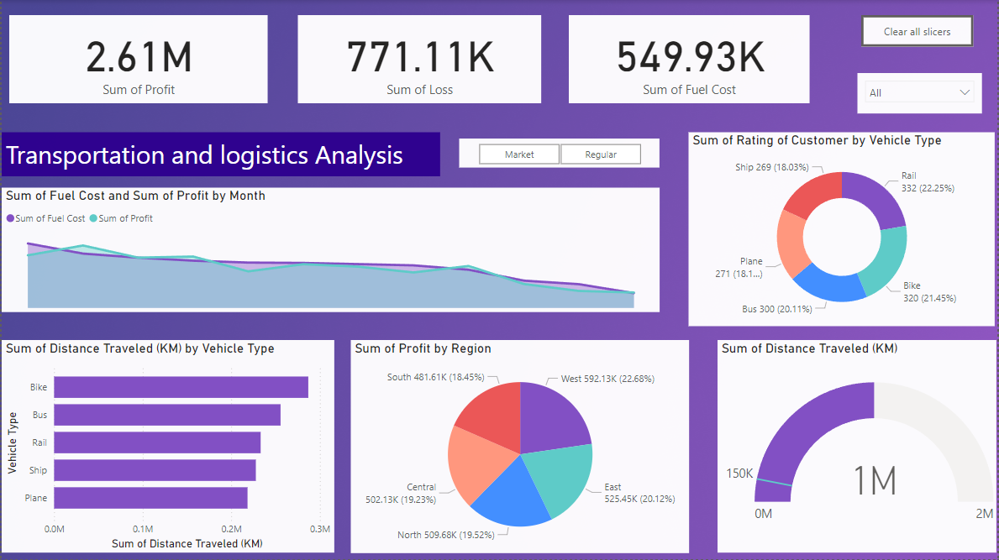
RESULTS AND DISCUSSIONS

Slide 16
CONCLUSION
The Transportation and Logistics Performance Dashboard in Power BI offers an integrated solution for monitoring key metrics like delivery times and vehicle utilization. It consolidates data from multiple sources to support better decision-making and operational planning.
Despite challenges with data integration and real-time updates, the dashboard achieved its objectives, providing an interactive, user-friendly tool for tracking performance.
Future Enhancements:
Predictive analytics for better forecasting
Mobile access for decision-making on the go
IoT integration for real-time tracking
In conclusion, the dashboard modernizes logistics management, promoting efficiency and continuous improvement to meet evolving industry demands.

Slide 17
REFERENCES
Anderson, R. (2021). Optimizing Transportation Performance through Data-Driven Dashboards. Analysis of how transportation companies use dashboards to track key performance indicators (KPIs) and improve efficiency.
Brooks, D., & Wallace, M. (2019). Logistics Dashboard Design: Best Practices and Implementation. A guide to designing dashboards for logistics performance management, highlighting critical metrics and visualization techniques.
Chen, Z., & Lin, Y. (2020). The Role of Dashboards in Supply Chain and Transportation Management. Study of how dashboards aid in real-time decision-making for transportation and supply chain managers.
Davis, S. (2018). Measuring Logistics Performance: Using Dashboards to Track KPIs. Examination of the key performance indicators commonly used in logistics and how dashboards help monitor and improve them.

Slide 18
THANK YOU
We thank God, Our Department, Guide, Panel Members, Supportive Professors and all Technical and non Technical staff who helped us in our Project.

